Slide 1


Mini-Project
Farming Assitant web service
Aldel Education Trust’s
St. John College of Engineering and Management, Palghar
NAAC Accredited with Grade A (2017-2022)
Department of Information Technology
Reenav Hemaria[1194028]
Shubham Kerkar[1194042]
Siddhesh Chavan [1194007]
Aishwarya Ingale[1194033]
Ms. Linda John| Asst. Professor

Slide 2
Contents
Abstract
Introduction
Literature Review
Proposed System (Block diagram)
Design and Implementation
Conclusion and Future scope

Slide 3
Abstract
Farming is the prime occupation in India. Even After All the Hard Work and The Production Done by The Farmers, In Today’s Market, The Farmers Are Cheated by the middlemen and take all the high margin profits, So the farmers don’t get better rates for their own products. Hence there arises a need to help the farmers to get better profits for their products. This project will be developed for the same purpose to eliminate the middlemen and farmers can directly sell on it.
Farmers and Consumers will have to first register themselves into the system. In farmers login sellers can add their products for sale and the consumers/buyers can buy the product directly from the farmers. So, the farmers will get better rates since the middleman is eliminated.
This application will be made with the help of HTML,BS, CSS, ReactJS. The proposed application will have two logins, one for farmers and other for the consumers. The database of this application will be created using Firebase.

Slide 4
Introduction
Farming is base of our culture it’s a basic source of income in India. So we think we can make a website that helps farmers to sell there product from there place and at their price.
There is no middle person in this so they can sell their crops with their profit basis.
The portal is user friendly and easy to understand for farmers.
There are clear instruction given how to use it.

Slide 5
Literature Review
Sr. No. | Paper Title [Ref.] | Author names | Advantage | Disadvantage | Journal and Year
[1] | Agro Bidding - A Smart Dynamic System for Enhancement of Farmer’s Lifestyle | Nalinipriya G, Sangeeta R, Saniya K | 1. In Agro Bidding system the base price is set by the seller. 2. The maximum price is attained by user in the advanced Bidding system. 3. All the goods are sold in order to avoid the wastage of products. | 1. The seller will be unaware of product which the customer wants to buy. 2. Not all auction system necessarily incurs these costs. 3. The bargaining price may deviate from other seller which depends on their individual skills set and reputation. | IEEE 2019

Slide 6
Literature Review
Sr. No. | Paper Title [Ref.] | Author names | Advantage | Disadvantage | Journal and Year
[2] | A Study of Blockchain Technology in Farmer’s Portal | Rahul Talreja, Rohan Chouksey, Sushma Verma | 1. It is enhancing the degree of participation, reducing the intermediation cost; many farmers experience difficulty when they try to sell their product at a fair price, the portal helps the farmers to reach the market without taking any extra help from the middlemen. 2. The use of blockchain ensures greater efficiency, trust, accessibility and transparency from farm to groceries. It will benefit users with more options and get competitive returns. 3. Improved level of customer interaction, customer and business loyalty will ensure increased workflow, smarter decision making and increased productivity. | 1. This application can be more refined with increasing integration of blockchain in a spectrum of areas and constellating it into a single paramount portal for farmers. 2.By putting farmer’s crop details to the blockchain, buyer’s data to the blockchain and adding more features and services to the single portal and bringing all possible facilities for farmers of the nation under sui generisawning. 3. Information integrity and precision issues can be solvedusing open, protected and trustedsystems presumptuous; theinfrastructure dispensation and footage connections areprotected and suitably provided. | IEEE 2020

Slide 7
Literature Review
Sr. No. | Paper Title [Ref.] | Author names | Advantage | Disadvantage | Journal and Year
[3] | PORTAL FOR FARMER TO SELL PRODUCT AT BETTER RATE | Chirag Namdeo Mande, Sneha Sankhe, Nitesh Uday Talekar | 1. direct communication is done in between the User and the farmer. 2. farmer can sell the product direct to the customer and the profit will get to the farmer. 3. Also the weather information is get to the farmer, in which weather did farmer should grow the particular crop. | 1. Portal can be further upgraded adding more features, where different sellers can sell their agriculture related products such as fertilizers and agriculture tools, etc. 2. A more advanced way of this portal can be made by providing farmers to sell their products to other countries. 3. Also another feature may contain that the buyer can see the location of farmer product. | IRJET 2021

Slide 8
Literature Review
Sr. No. | Paper Title [Ref.] | Author names | Advantage | Disadvantage | Journal and Year
[4] | Implementing E-Commerce model for Agricultural Produce: A Research Roadmap | Tumpa Banerjee, Monalisa Mishra Narayan C. Debnath , Prasenjit Choudhury4 | 1. Farmer can sell the product direct to the customer and the profit will get to the farmer. 2. Benefits the growers to present their yield in a wider market irrespective of the physical distance and reach the consumer directly. 3. Improve the financial status of the growers and economic growth of the country | 1. Constituting an E-Commerce portal for trading agricultural products is a demanding task 2. Operating the system with prosperity is more challenging. 3. Very few people are using this new marketing system for which the achievement of success is taking time. | PEN 2019

Slide 9
Literature Review
Sr. No. | Paper Title [Ref.] | Author names | Advantage | Disadvantage | Journal and Year
[5] | An Efficacious E-Portal for Rancher to Buy Seeds and Humus. | Raghu Raman D, Saravanan D, Nivedha R | 1. This portal is easier for accessing than the existing portal. 2. It is developed to eradicate the involvement of third person. 3. It can be accessed by any people where they are user friendly. | 1. Costing of this E-website is high. 2. Implementation of such E-website is a difficult task. 3. Farmers do not have knowledge about the web applications, Online auction, etc. | IJRTE 2019

Slide 10
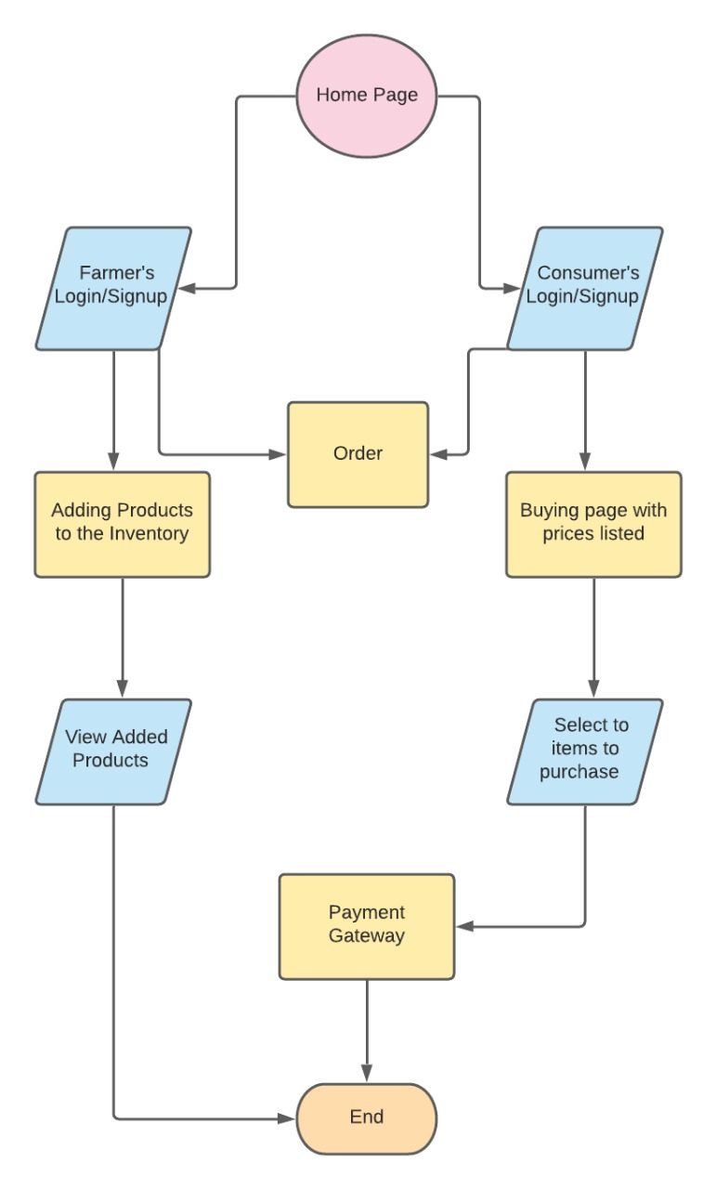
Proposed system(Block Diagram)

Slide 11
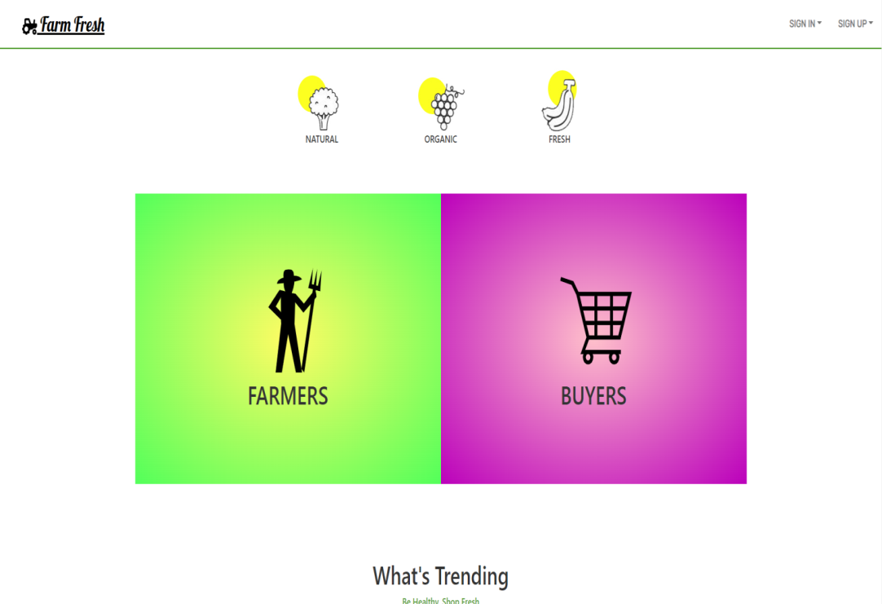
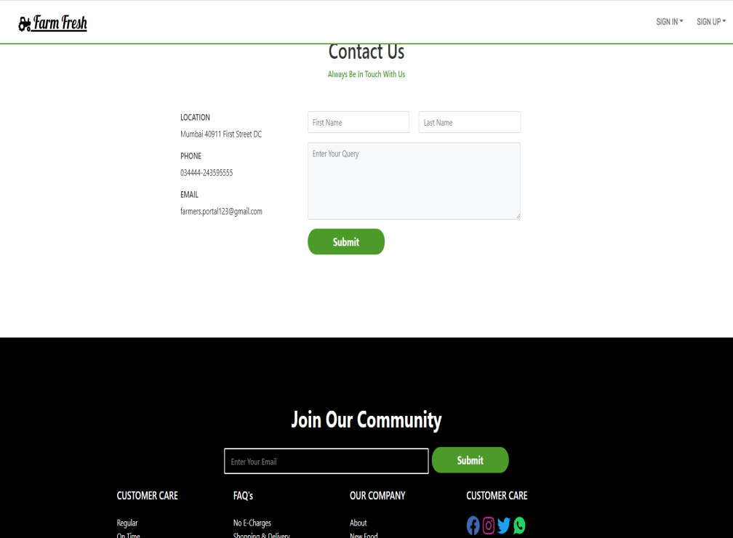
Implementation
Farm Fresh (Home page)
Home of the system where all features are enlisted

Slide 12
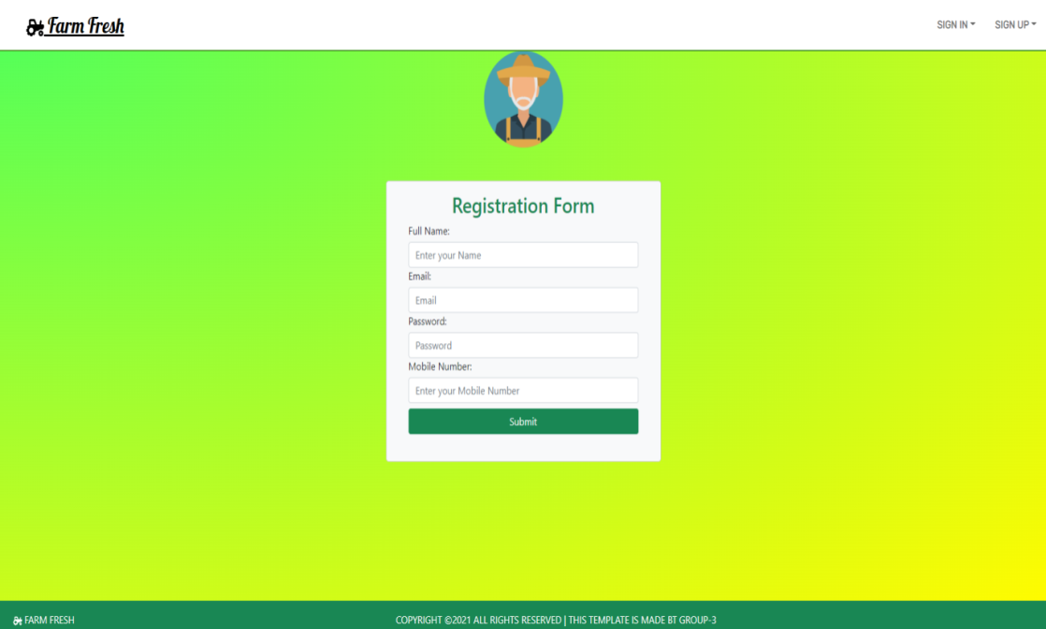
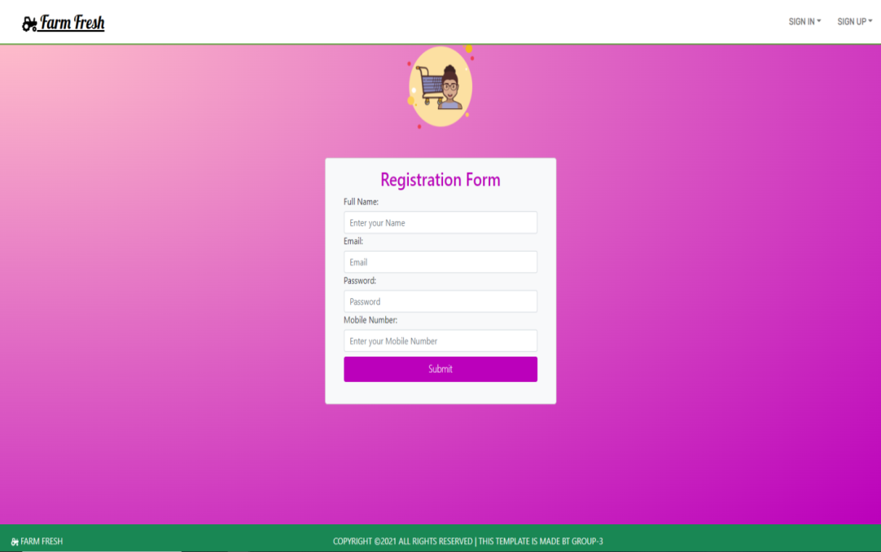
Implementation
Sign Up page
Sign up Pages for Farmer and Consumer can be seen here.

Slide 13
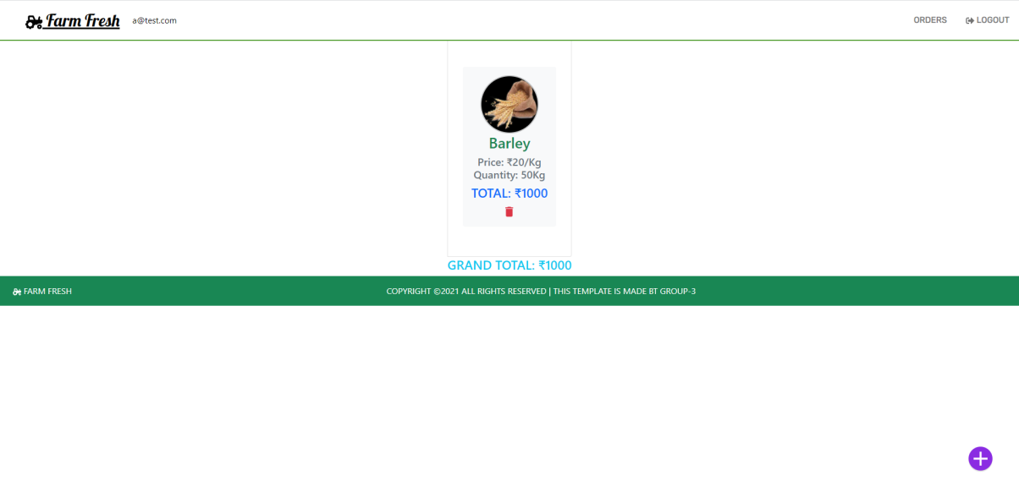
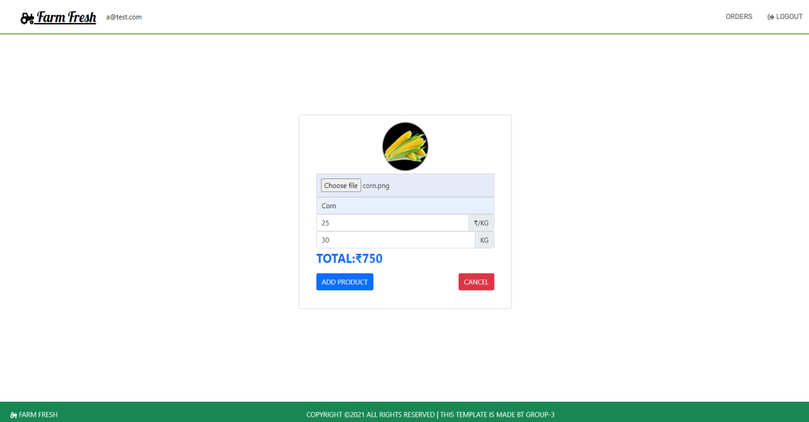
Implementation
Add Product Page
List of all Added products and Add products page in Farmer Side can be seen here.

Slide 14
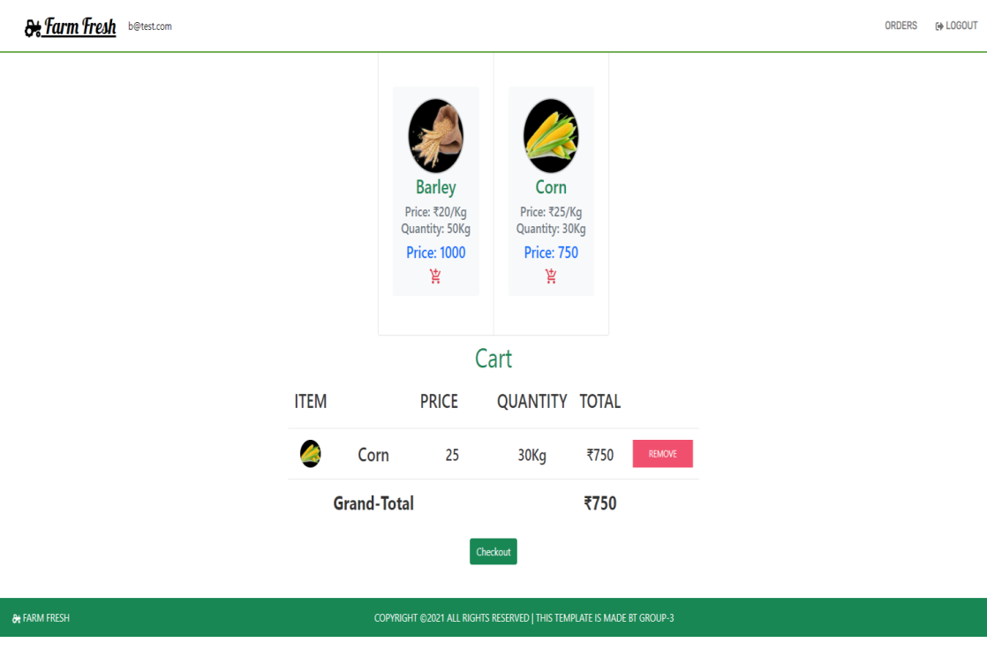
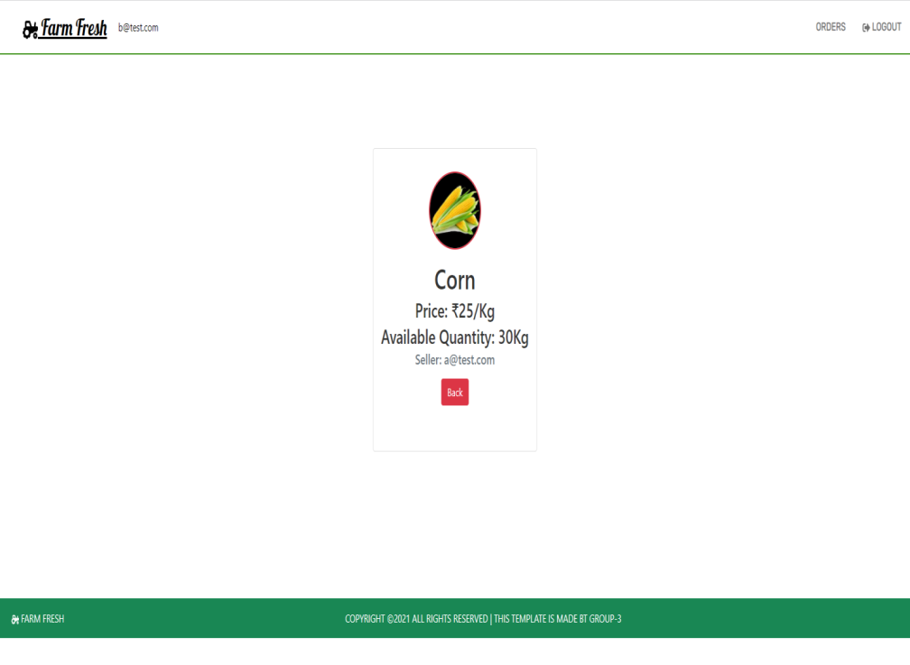
Implementation
View Product and Cart
Product details such as price, owner, description and Cart on consumer side can be seen here

Slide 15
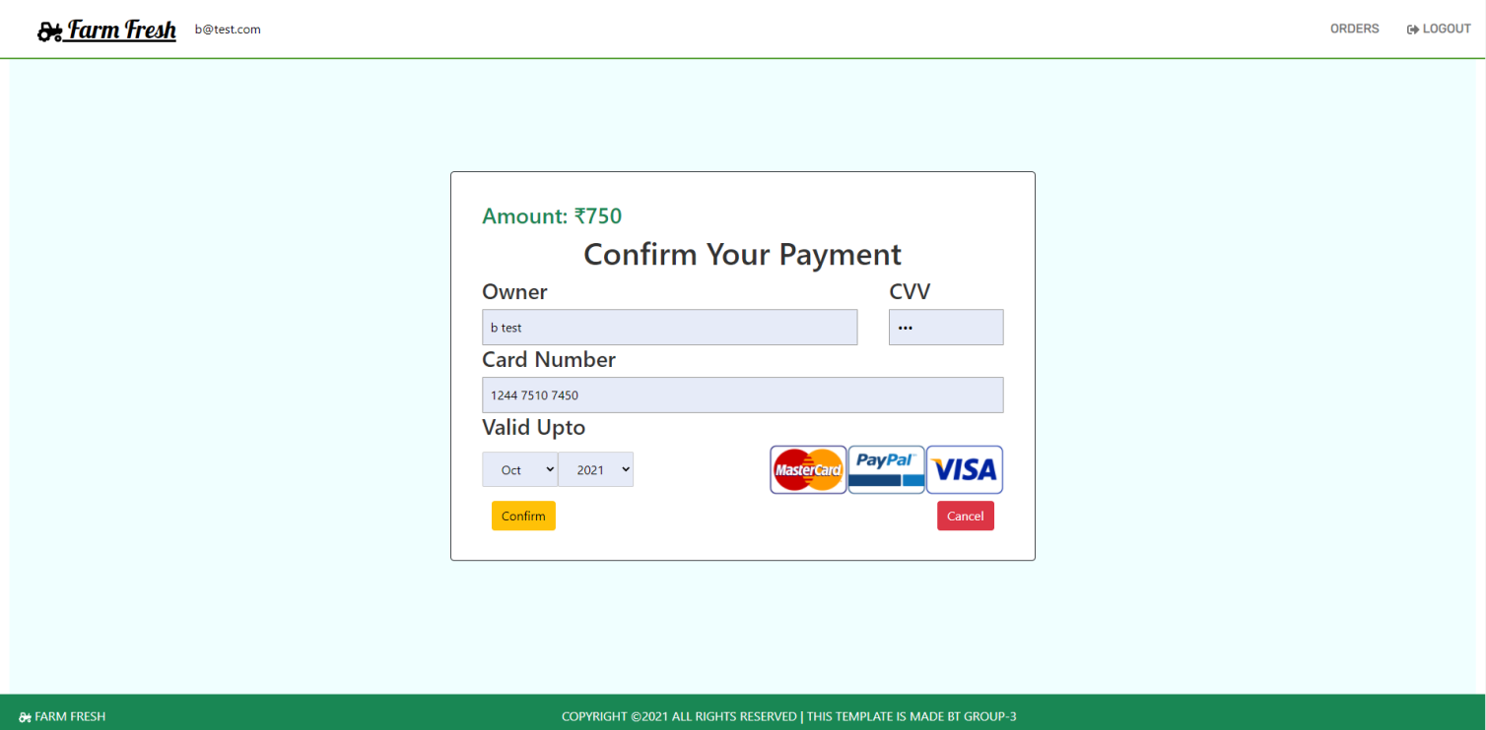
Implementation
Payment Gateway
Payment Gateway on Consumer side can be seen here.

Slide 16
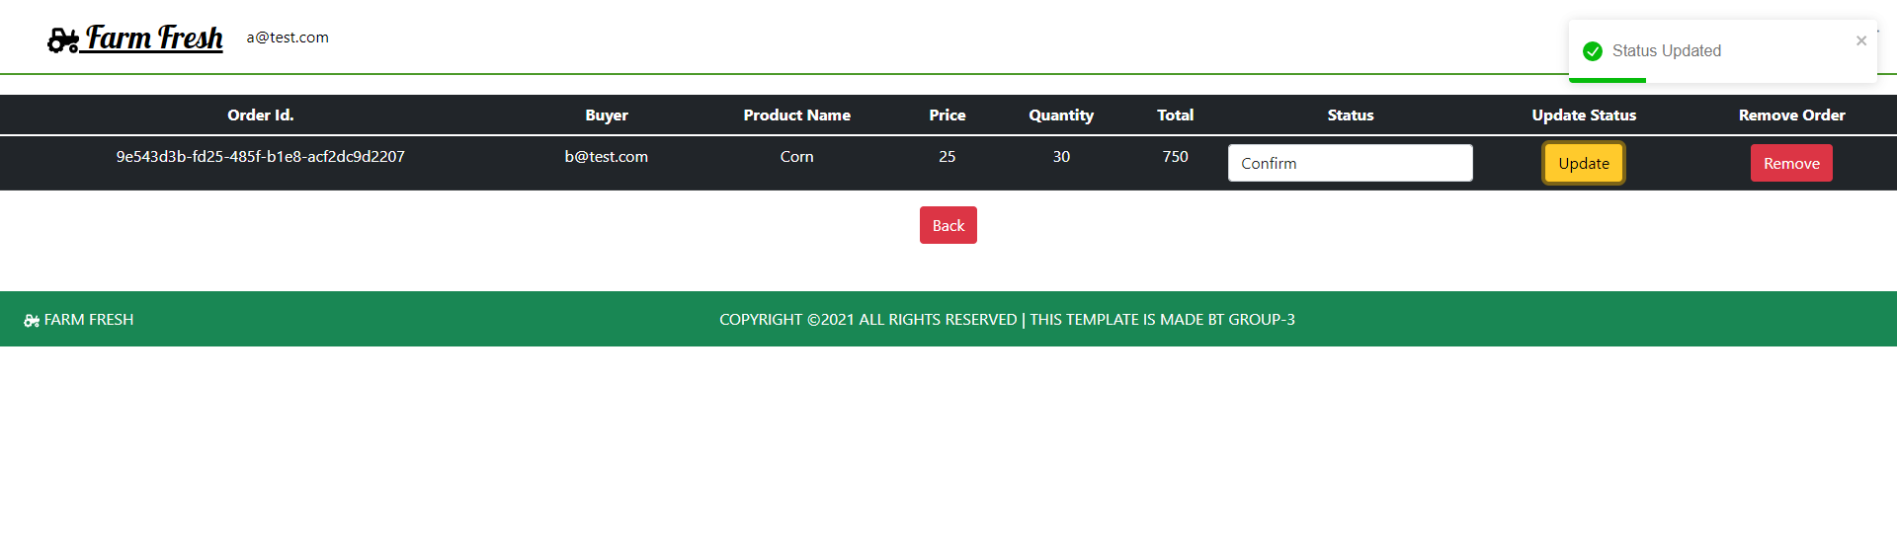
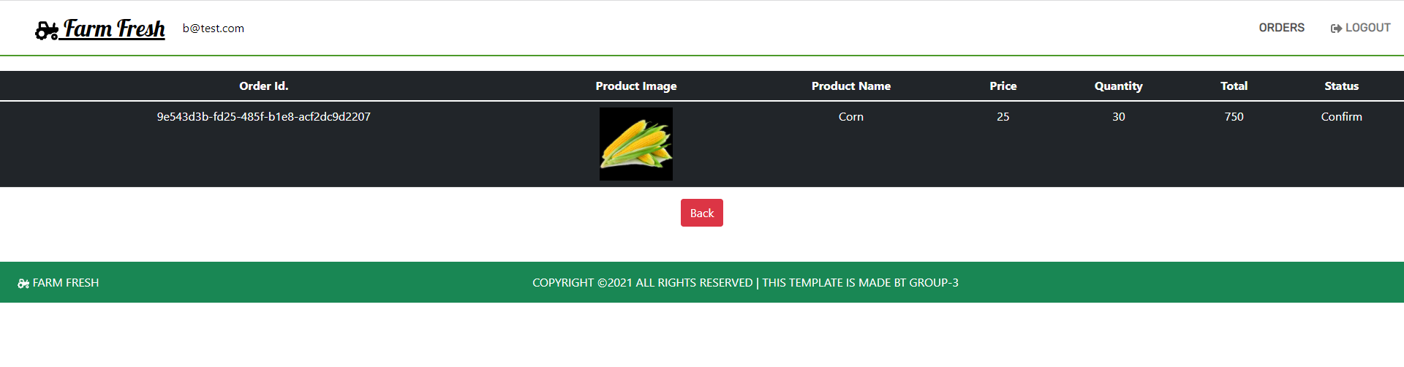
Implementation
Order page
Farmers can Update the Status of the received order and Consumer can view details of order placed.

Slide 17
Conclusion and Future scope
The portal is for the growth of farmer and increases their important in marketing field.
This Portal can be further upgraded adding more features, where different sellers can sell their agriculture related products such as fertilizers and agriculture tools, etc.
Future Scope
A more advanced way of this portal can be made by providing farmers to sell their products to other countries. Also another feature may contain that the buyer can see the location of farmer product.
Adding an secure socket layer would prevent data’s from third parties. More graphics can be added to attract users.

Slide 18
Thank You !!!

Slide 19
Q & A

